Slide 1

Dennis Oberst
Speed Up with
QtGrpc & QtProtobuf
Speed Up Your Remote Communication with
QtGrpc & QtProtobuf

Slide 2


Introduction
“... are Google's language-neutral, platform-neutral, extensible mechanism for serializing structured data.”
“... is a modern, open source, high-performance remote procedure call (RPC) framework that can run anywhere.“

Slide 3


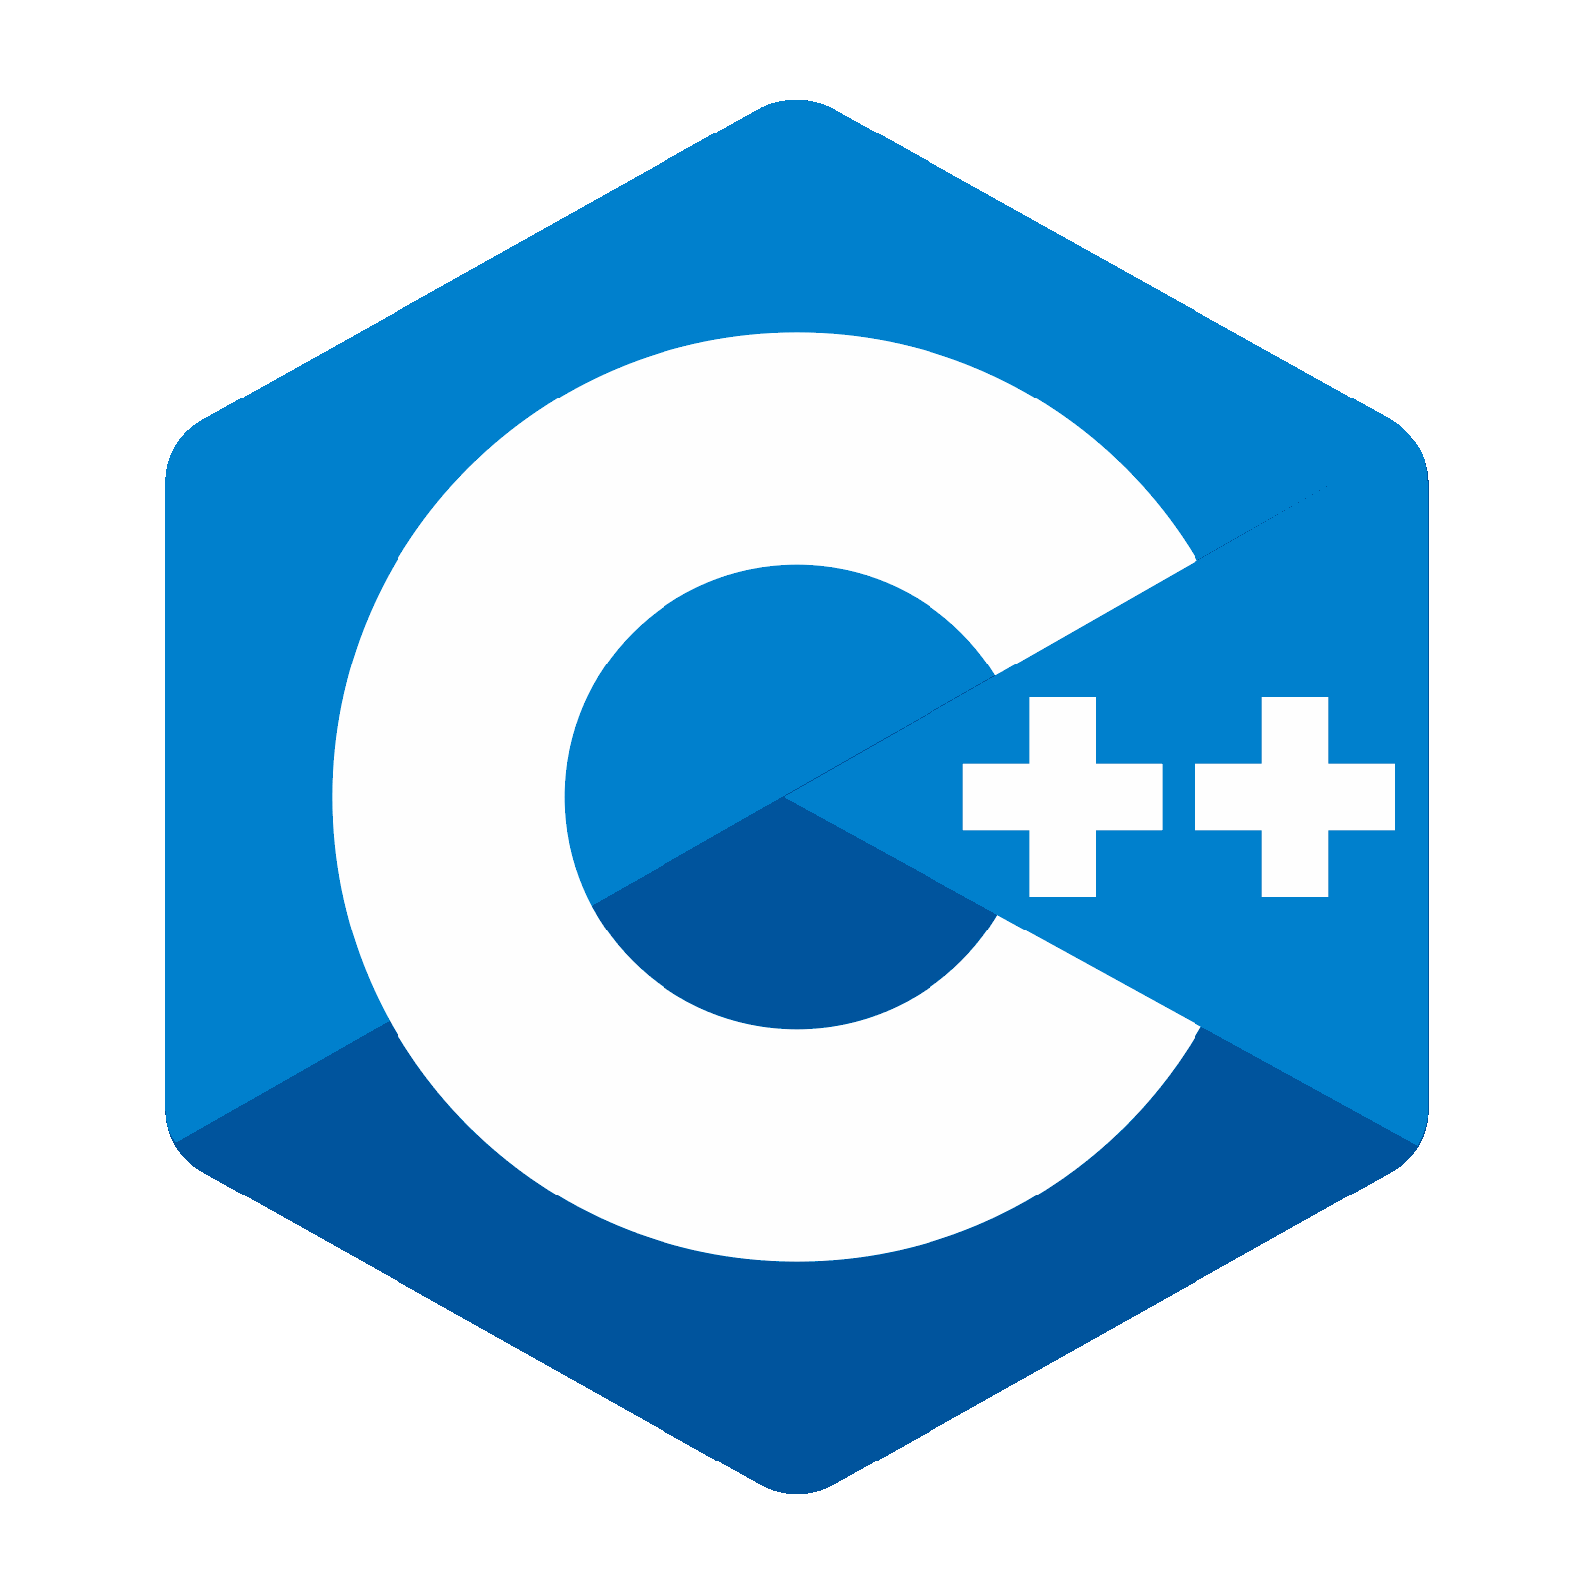

Protobuf
Language
Compiler
Library
// event.proto
syntax = "proto3";
message Event {
enum Type {
UNKNOWN = 0;
USER = 1;
SYSTEM = 2;
}
Type type = 1;
string name = 2;
}
#include "event.pb.h"
...
int main(int argc, char *argv[])
{
Event e1;
e1.set_type(Event::USER);
e1.set_name("User.json");
Event e2;
e2.set_type(Event::SYSTEM);
e2.set_name("Sys.proto");
printSerialized("JSON : "
+ messageToJsonString(e1));
printSerialized("PROTO: "
+ e2.SerializeAsString());
}
—java_out
—python_out
—cpp_out
—rust_out
...
protoc
Protocol Buffer
Code Generation
Serialization

Slide 4
Protobuf
protoc —cpp_out=. event.proto
g++ main.cpp event.pb.cc –o event_proto \
$(pkg-config --libs protobuf)
./event_proto
JSON : {"type":"USER","name":"User.json"}
PROTO: \x08\x02\x12\x09Sys.proto
Bytes used
34
13
9 bytes
Field 2 (name): LEN
SYSTEM
Field 1 (type): VARINT

Slide 5
Protobuf
2x
~0.7x
3.5x
~1.5x
6.5x
~5x
~2x
~2x
Reference

Slide 6


Protobuf
Schema-Driven API
Language-Independent
Strongly typed definitions
Safe evolution & versioning
Dependency on schema definition
Not human-readable
Integration complexity
2. Code Generation
Optimized for each target language
Extensible Plugin Ecosystem
3. Performance
Fast serialization & deserialization
Compact binary format

Slide 7
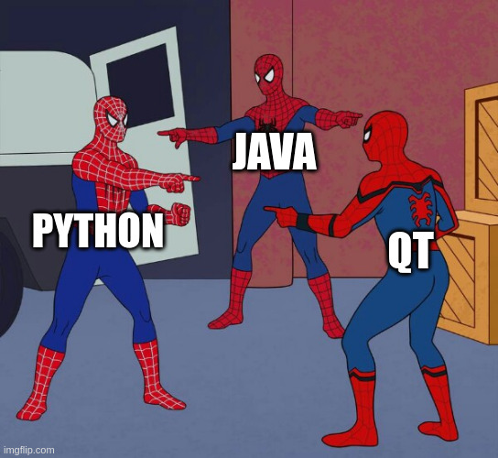


Protobuf
QtProtobuf

Slide 8

QtProtobuf
Schema-Driven API
Language-Independent
Strongly typed definitions
Safe evolution & versioning
Code Generation
Optimized for each target language
Extensible Plugin Ecosystem
Performance
Fast serialization & deserialization
Compact binary format
Proto Messages as native Qt C++ types
Meta-object system compatible
Easy use in models, views and signals
Uses familiar Qt types
Proto Messages as native Qt QML types
Integrated tooling & build system
Smooth conversion of QtGui & QtCore types

Slide 9
Protobuf
QtProtobuf
#include "event.pb.h"
...
int main(int argc, char *argv[])
{
Event e1;
e1.set_type(Event::USER);
e1.set_name("User.json");
Event e2;
e2.set_type(Event::SYSTEM);
e2.set_name("Sys.proto");
std::string e1Serialized;
google::protobuf::util::MessageToJsonString(
e1, &e1Serialized);
printSerialized("JSON : "
+ e1Serialized);
printSerialized("PROTO: "
+ e2.SerializeAsString());
}
#include "event.qpb.h"
...
int main(int argc, char *argv[])
{
Event e1;
e1.setType(Event::Type::USER);
e1.setName("User.json");
Event e2;
e2.setType(Event::Type::SYSTEM);
e2.setName("Sys.proto");
QProtobufSerializer protoSer;
QProtobufJsonSerializer jsonSer;
printSerialized("JSON : "
+ e1.serialize(&jsonSer));
printSerialized("PROTO: "
+ e2.serialize(&protoSer));
}
.qpb.h prefixed
camelCase
Scoped Enums
Separate Serializer
Notes:
We also allow for snake_case generation

Slide 10
Protobuf
QtProtobuf
protoc —cpp_out=. event.proto
g++ main.cpp event.pb.cc –o event_proto \
$(pkg-config --libs protobuf)
protoc —qtprotobuf_out=. \
—plugin=protoc-gen-qtprotobuf=\
$(which qtprotobufgen) event.proto
moc ...
g++ main.cpp event.qpb.cc –o event_qtproto \
$(pkg-config --libs Qt6Protobuf)
./event_proto
JSON : {"type":"USER","name":"User.json"}
PROTO: \x08\x02\x12\x09Sys.proto
./event_qtproto
JSON : {"name":"User.json","type":"USER"}
PROTO: \x08\x02\x12\x09Sys.proto

Slide 11
QtProtobuf QML
find_package(Qt6 REQUIRED COMPONENTS
Protobuf ProtobufQuick)
qt_standard_project_setup(REQUIRES 6.9)
qt_add_executable(event_qml main.cpp)
qt_add_qml_module(event_qml
URI Event
QML_FILES Main.qml
SOURCES serializer.h
)
add_library(event_qml_proto STATIC)
qt_add_protobuf(event_qml_proto
QML QML_URI Event.Proto
PROTO_FILES event.proto
)
target_link_libraries(event_qml PRIVATE
Qt6::Protobuf Qt6::ProtobufQuick
event_qml_proto
)

Slide 12
QtProtobuf QML
import Event Main.qml
import Event.Proto
ApplicationWindow {
id: root
property event event // from Event.Proto
onEventChanged: serializer.update()
property string data
Serializer { // from Event
id: serializer
onTypeChanged: update()
function update() {
root.data = serialize(root.event)
}
}
ComboBox {
model: [
{ text: "UNKNOWN", value: Event.Type.UNKNOWN },
{ text: "USER", value: Event.Type.USER },
{ text: "SYSTEM", value: Event.Type.SYSTEM }
]
onActivated: root.event.type = currentValue
}
TextField {
text: root.event.name
onTextEdited: root.event.name = text
}
// display serialized event, select serializer type ...
}
Generated module
#include "event.qpb.h" serializer.h
...
class Serializer : public QObject
{
Q_OBJECT
QML_ELEMENT
Q_PROPERTY(Type type MEMBER mType NOTIFY typeChanged)
public:
enum Type { Proto, Json }; Q_ENUM(Type)
Q_INVOKABLE QByteArray serialize(const Event &msg) {
return mType == Proto
? msg.serialize(&mProtoSerializer)
: msg.serialize(&mJsonSerializer);
}
Q_INVOKABLE QString display(const QByteArray &msg)
{ /* prettify serialized @msg */ }
signals:
void typeChanged();
private:
Type mType
QProtobufSerializer mProtoSerializer;
QProtobufJsonSerializer mJsonSerializer;
};
QML_VALUE_TYPE

Slide 13
QtProtobuf QML
class Serializer : public QObject serializer.h
{
Q_OBJECT
QML_ELEMENT
Q_PROPERTY(Type type MEMBER mType NOTIFY typeChanged)
Q_PROPERTY(Event event MEMBER mEvent NOTIFY eventChanged)
Q_PROPERTY(QByteArray data READ data NOTIFY dataChanged)
public:
enum Type { Proto, Json }; Q_ENUM(Type)
Serializer(QObject *parent = nullptr)
: QObject(parent)
{
connect(this, &Serializer::typeChanged,
&Serializer::serialize);
connect(this, &Serializer::eventChanged,
&Serializer::serialize);
}
void serialize() {
mData = mType == Proto
? mEvent.serialize(&mProtoSerializer)
: mEvent.serialize(&mJsonSerializer);
emit dataChanged();
}
Q_INVOKABLE QString display(const QByteArray &msg)
{ /* prettify serialized @msg */ }
private:
Type mType;
Event mEvent;
QByteArray mData;
QProtobufSerializer mProtoSerializer;
QProtobufJsonSerializer mJsonSerializer;
};
import Event Main.qml
import Event.Proto
ApplicationWindow {
id: root
Serializer {
id: serializer
type: serializeSelector.currentValue
}
ComboBox {
model: [
{ text: "UNKNOWN", value: Event.Type.UNKNOWN },
{ text: "USER", value: Event.Type.USER },
{ text: "SYSTEM", value: Event.Type.SYSTEM }
]
onActivated: serializer.event.type = currentValue
}
TextField {
text: serializer.event.name
onTextChanged: serializer.event.name = text
}
ComboBox {
id: serializeSelector
model: [
{ text: "Proto", value: Serializer.Proto },
{ text: "Json", value: Serializer.Json },
]
}
TextField { text: serializer.display(serializer.data)) }
TextField { text: "size " + String(serializer.data).length }
}

Slide 14
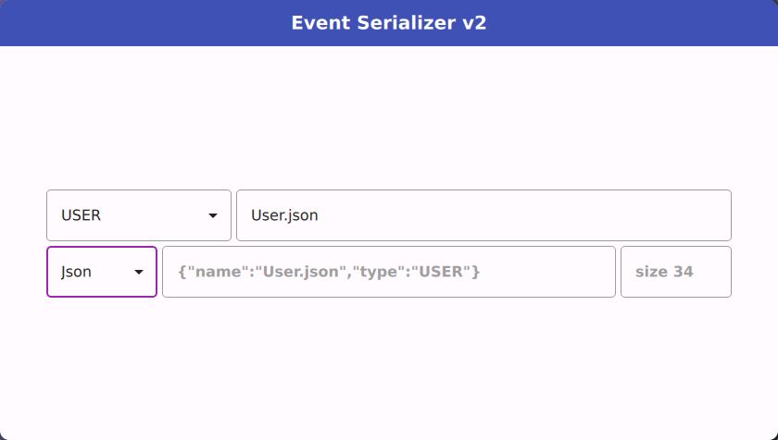
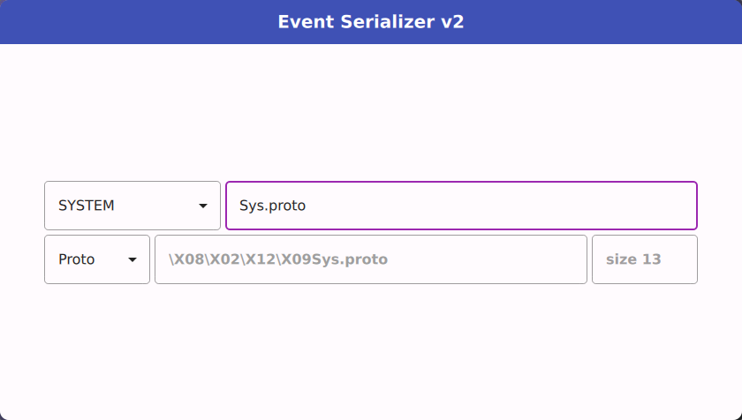
QtProtobuf QML
DEMO

Slide 15


Slide 16
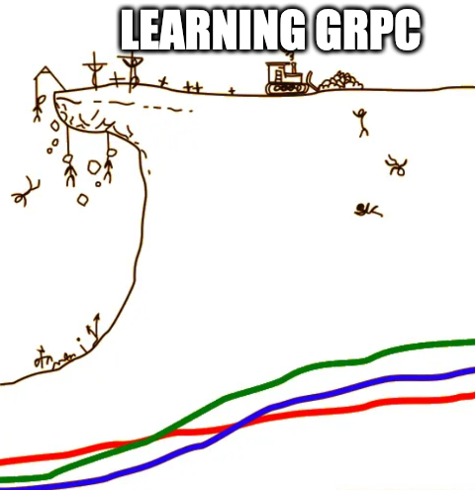
gRPC
Remote Procedure Calls
Execute methods on remote systems as if they were local calls.
Abstracts network details by hiding complexities
Where is it used?
Microservice Architecture
Real-Time & Streaming Apps
Cross-Platform & Multi-language Environments

Slide 17
gRPC
protoc --plugin=protoc-gen-grpc= \
$(which grpc_cpp_plugin) eventhub.proto
Protobuf Definitions
Interfaces for RPCs
syntax = "proto3"; // eventhub.proto
import "event.proto";
message None {}
service EventHub {
rpc Push(Event) returns (None) {}
rpc Subscribe(None) returns(stream Event) {}
rpc Notify(stream Event) returns (None){}
rpc Exchange (stream Event) (stream Event) {}
}
// eventhub.grpc.pb.h
class EventHub {
static std::unique_ptr<Stub> NewStub(channel); // “Client”
// Stub interfaces ...
class Service { // “Server”
virtual grpc::Status Push(...);
virtual grpc::Status Subscribe(...);
virtual grpc::Status Notify(...);
virtual grpc::Status Exchange(...);
};
};
Service
Synchronous

Slide 18
gRPC
protoc --plugin=protoc-gen-grpc= \
$(which grpc_cpp_plugin) eventhub.proto
Protobuf Definitions
Interfaces for RPCs
syntax = "proto3"; // eventhub.proto
import "event.proto";
message None {}
service EventHub {
rpc Push(Event) returns (None) {}
rpc Subscribe(None) returns(stream Event) {}
rpc Notify(stream Event) returns (None){}
rpc Exchange (stream Event) (stream Event) {}
}
// eventhub.grpc.pb.h
class EventHub {
static std::unique_ptr<Stub> NewStub(channel); // “Client”
// Stub interfaces ...
class CallbackService { // “Server”
virtual grpc::ServerUnaryReactor* Push(...);
virtual grpc::ServerWriteReactor<Event>* Subscribe(...);
virtual grpc::ServerReadReactor<Event>* Notify(...);
virtual grpc::ServerBidiReactor<Event,Event>* Exchange(...);
};
};
Service
Asynchronous Callback

Slide 19
gRPC
protoc --plugin=protoc-gen-grpc= \
$(which grpc_cpp_plugin) eventhub.proto
Protobuf Definitions
Interfaces for RPCs
syntax = "proto3"; // eventhub.proto
import "event.proto";
message None {}
service EventHub {
rpc Push(Event) returns (None) {}
rpc Subscribe(None) returns(stream Event) {}
rpc Notify(stream Event) returns (None){}
rpc Exchange (stream Event) (stream Event) {}
}
// eventhub.grpc.pb.h
class EventHub {
static std::unique_ptr<Stub> NewStub(channel); // “Client”
// Stub interfaces ...
class AsyncService { // “Server”
void RequestGetEvent(...);
void RequestSubscribe(...);
void RequestNotify(...);
void RequestExchange(...);
};
};
Service
Asynchronous

Slide 20
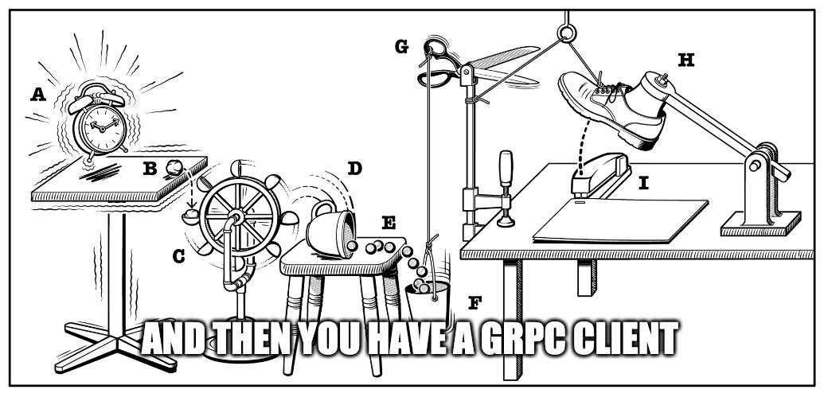
gRPC

Slide 21

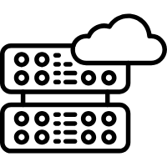





gRPC
STREAM
SINGLE

Slide 22




gRPC
STREAM
SINGLE

Slide 23

gRPC
STREAM
SINGLE
Channel
Transportation
Multiplexing
Request
Response
RPC

Slide 24
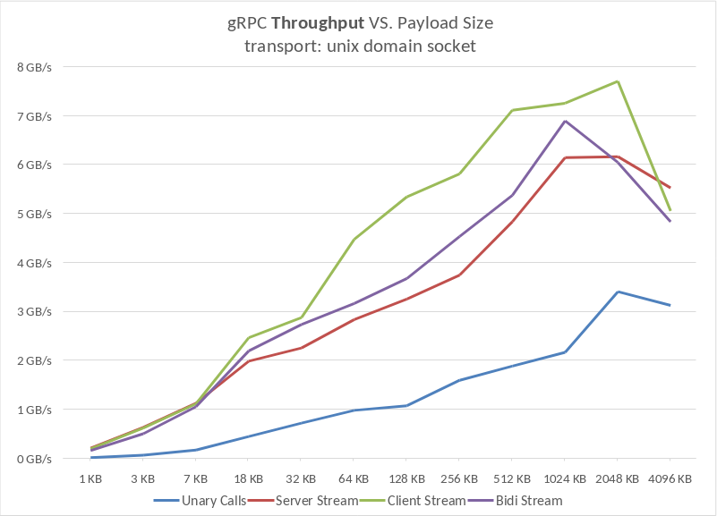
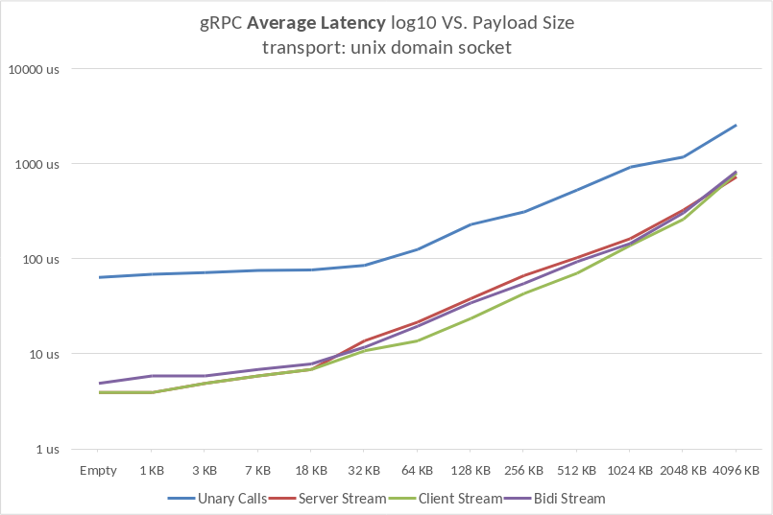
gRPC
Reference

Slide 25

gRPC

Slide 26




gRPC
45% faster connect latency in P95s
Reference
“Incredible reduction in P99s”
Developer productivity
Reduced code complexity
Reference
Stability, Performance, Latency
Standardization (Integrating new Devs)
Ecosystem (LB, Caching, 3rdparty tools)
Reference
Standardization + Uniformity,
Reduction in boilerplate code
Reference
Notes:
Spotify: Coming from: Hermes (ZeroMQ), json/protobuf payload
Dropbox: gRPC integration in Courier

Slide 27
gRPC
Performance
Binary encoding / decoding
Compact & fast transmission
Low latency
HTTP/1.x <> HTTP/2 Incompatible
No Browser support for HTTP/2
gRPC-Web Proxy
Integration Complexity
2. Schema-Driven API
Language-Independent
Strongly typed definitions
Safe evolution & versioning
3. HTTP/2 Foundation
Multiple parallel Streams
Real-time data exchange
Fine-Grained networking options

Slide 28
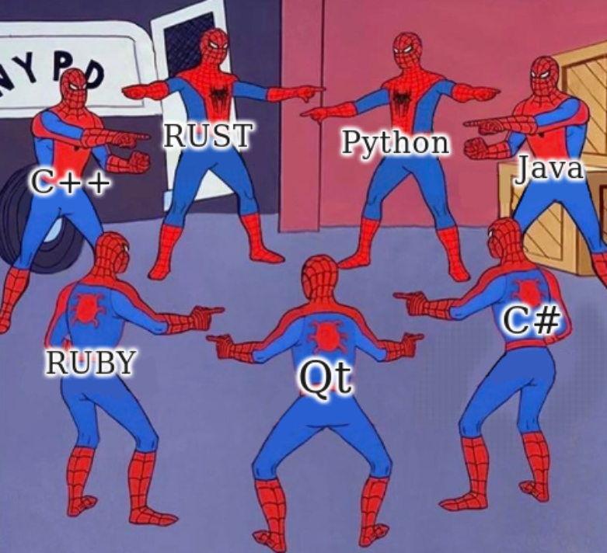
gRPC
Protobuf
QtProtobuf
QtGrpc

Slide 29
QtGrpc
Performance
Binary encoding / decoding
Compact & fast transmission
Low latency
QtGrpc C++ Integration
Signals & Slots
Qt Networking
Qt Event Loop
2. Schema-Driven API
Language-Independent
Strongly typed definitions
Safe evolution & versioning
QtGrpc QML Integration
Quick RPCs for GUIs
Tooling & Build Integration
Great Documentation & Examples
3. Channels (HTTP/2)
Multiple parallel Streams
Real-time data exchange
Fine-Grained networking options
Since Qt 6.8 ...
A “Real” Qt Module
Stable & Binary Compatible APIs
Many performance improvements

Slide 30
QtGrpc
protoc --plugin=protoc-gen-qtgrpc= \
$(which qtgrpcgen) eventhub.proto
Protobuf Definitions
Qt Interfaces for RPCs
syntax = "proto3"; // eventhub.proto
import "event.proto";
message None {}
service EventHub {
rpc Push(Event) returns (None) {}
rpc Subscribe(None) returns(stream Event) {}
rpc Notify(stream Event) returns (None){}
rpc Exchange (stream Event) (stream Event) {}
}
// eventhub_client.grpc.qpb.h
namespace EventHubService {
class Client : public QGrpcClientBase
{
...
std::unique_ptr<QGrpcCallReply> Push(const Event &arg);
std::unique_ptr<QGrpcServerStream> Subscribe(const None &arg);
std::unique_ptr<QGrpcClientStream> Notify(const Event &arg);
std::unique_ptr<QGrpcBidiStream> Exchange(const Event &arg);
...
};
} // namespace EventHubService
Service
Asynchronous

Slide 31
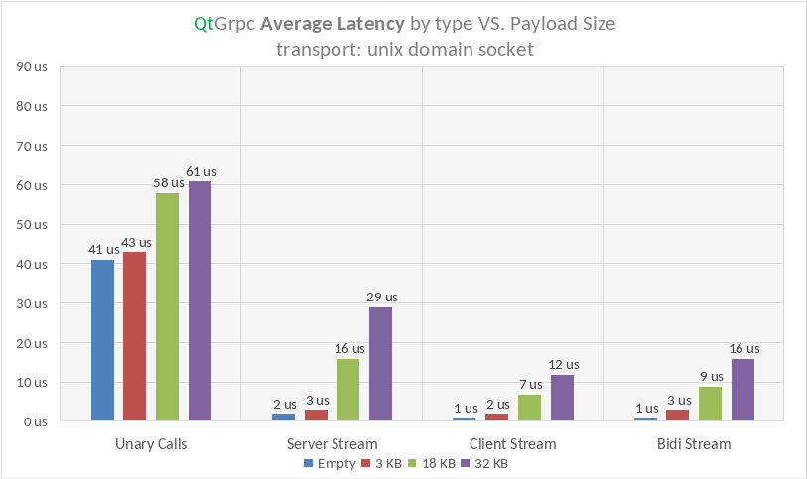
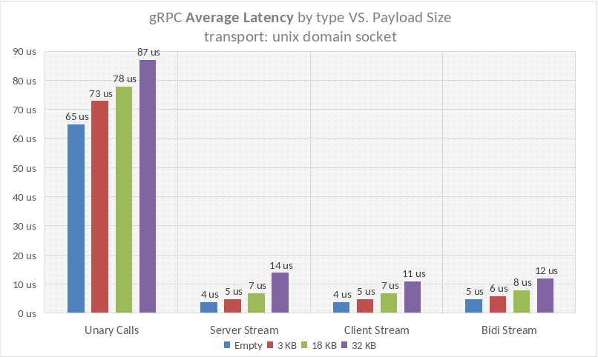
QtGrpc
Reference

Slide 32
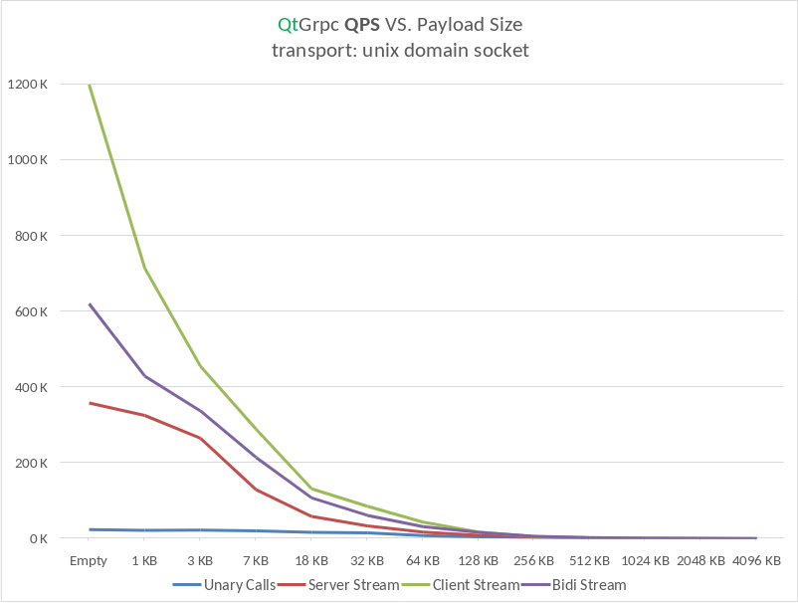
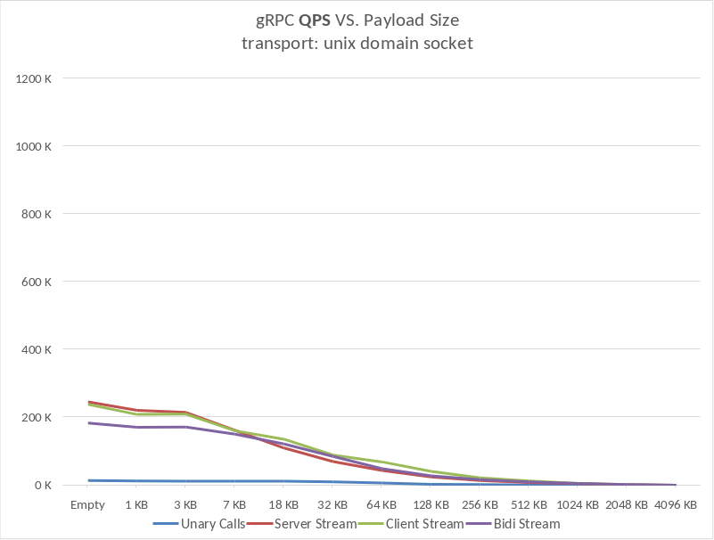
QtGrpc
Reference

Slide 33
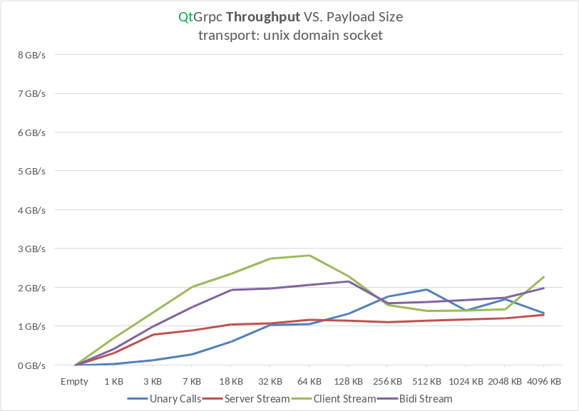
QtGrpc
Reference

Slide 34
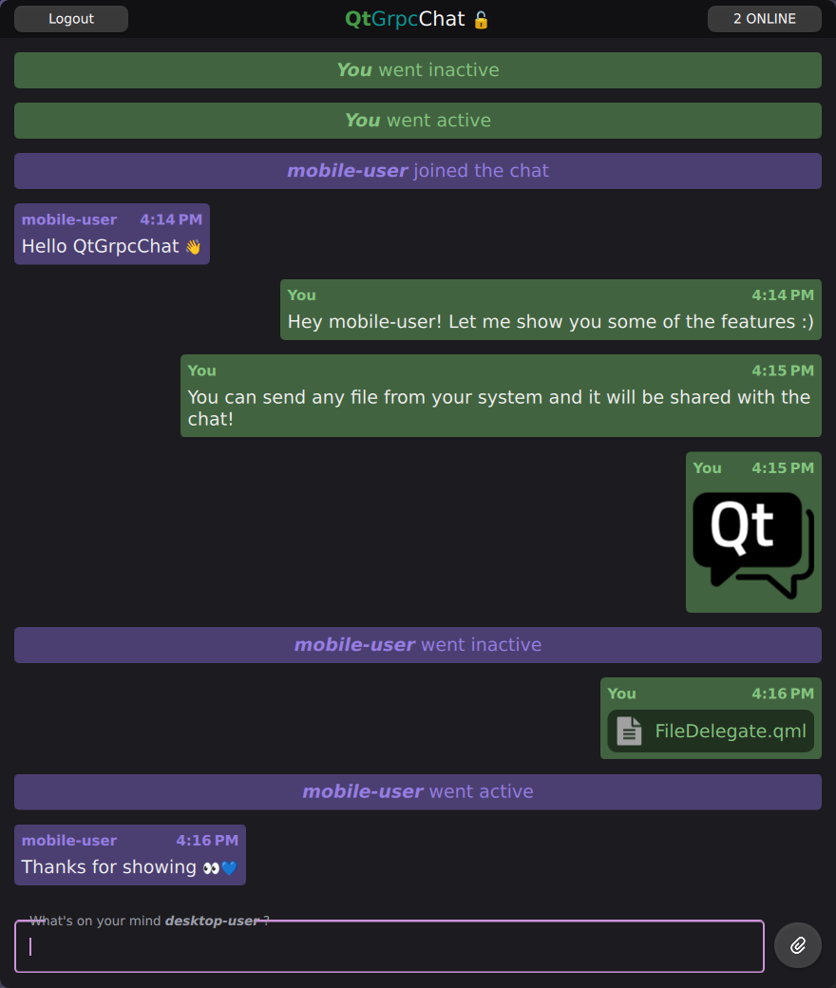
QtGrpc
DEMO

Slide 35





DENNIS OBERST
linkedin.com/in/deeedob
github.com/deeedob
dennis.oberst@qt.io

